Slide 1

jDMN: An execution engine in Java
Dr. Octavian Patrascoiu
DecisionCAMP September 17-19, 2018

Slide 2
Content
Why jDMN?
Overall structure
Translation to Java
Code optimisation
Q&As

Slide 3
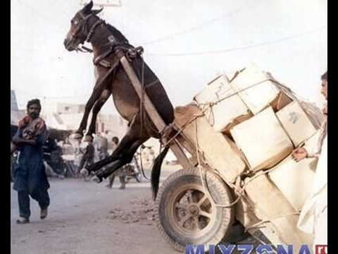
Why jDMN?

Slide 4
Overall Structure
DMN Processors
Reader / Writer
Validators
Transformers
Interpreter
Translator
Dialects
DMN 1.1 &1.2
Signavio

Slide 5
Overall Structure
Syntax Analyzer
Source
Text
Lexical Analyzer
Source
Tokens
Parser
AST
Semantic Analyzer
Error Manager
& Logger
Semantic
Tree
Code
Generator
Interpreter

Slide 6
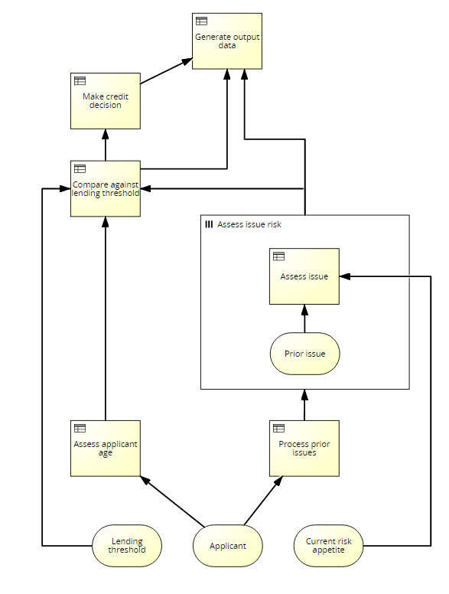
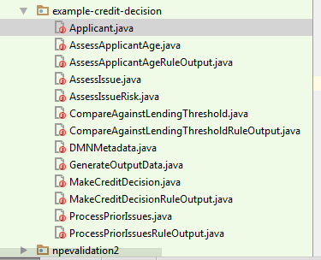
Translation to Java

Slide 7
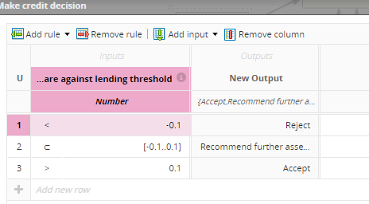
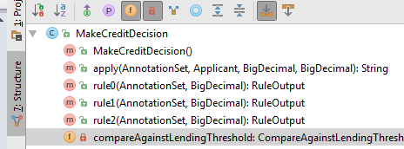
Translation to Java

Slide 8
Translation to Java
How did we built it?
Syntax-Driven Translation Schematas (SDTS)
Based on Knuth’s attributed gramars
Synthesized attributes
Inherited Attributes
Expr₁ → Expr₂ + Term { Expr₁.value = Expr₂.value + Term.value }
Expr → Term { Expr.value = Term.value }
Term₁ → Term₂ * Factor { Term₁.value = Term₂.value * Factor.value }
Term → Factor { Term.value = Factor.value }
Factor → "(" Expr ") { Factor.value = Expr.value }
Factor → integer { Factor.value = strToInt(integer.str) }

Slide 9
Translation to Java
Advantages include
Performance: we have seen runtimes 4-10 times faster than previous engine execution in complex decision tests
Stability: given that we now control the code-generation, we are able to resolve issues in without relying on the vendor
Functionality: the fact that we control the code-generation means that we are also able to enable more advanced functionality for DMN/Java models

Slide 10
Code Optimisation
Local optimisation
Types
Built-in functions
Global optimisation
Lazy evaluation
Code layout – template providers
Caching

Slide 11
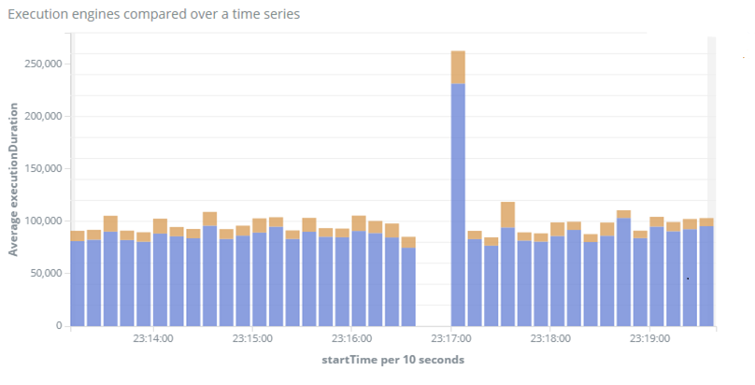
Performance
jDMN
Previous

Slide 12

Questions?
https://github.com/goldmansachs/jdmn

